Slide 1
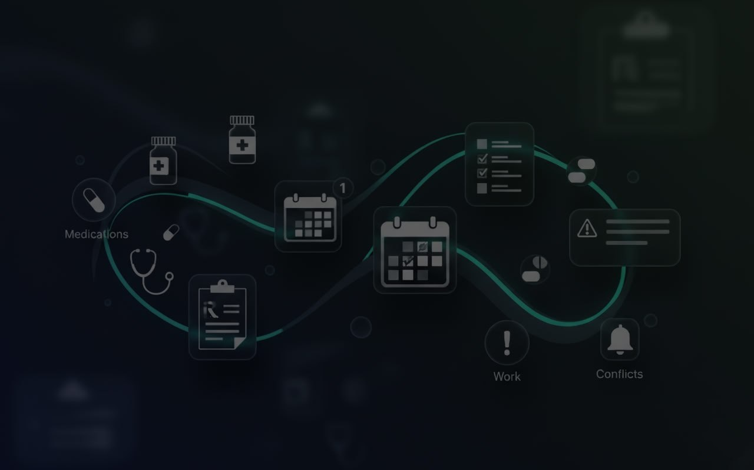
UmiDo
AI-Powered Smart Notification System
UmiZoomi
202255636 Kadyrov Adilet
202255634 Yegizbayev Zholan

Slide 2
The Problem: A Fragmented Life
Challenge: Individuals face increasing difficulty managing responsibilities across healthcare, work, and personal domains.
Cognitive Overload: Overlapping schedules and conflicting priorities lead to inefficiencies, missed commitments, and decreased productivity.
Tool Limitation: Traditional task management tools are often passive, disconnected, and lack the holistic integration and AI-driven prioritization needed for modern life.

Slide 3
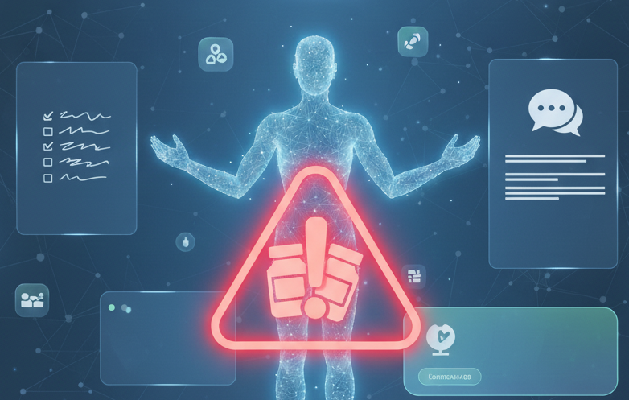
The Vision: A Proactive, Intelligent Assistant
Project Goal: To develop an AI-powered system that intelligently coordinates and prioritizes tasks across different domains, moving beyond simple reminders to proactive support.
Core Objectives:
Develop an AI-Powered Prescription Parser for effortless task entry.
Create an integrated communication and monitoring hub with an AI chatbot.
Build a system that detects and resolves both scheduling and drug-drug interaction conflicts.
Implement robust offline capabilities to ensure constant accessibility

Slide 4
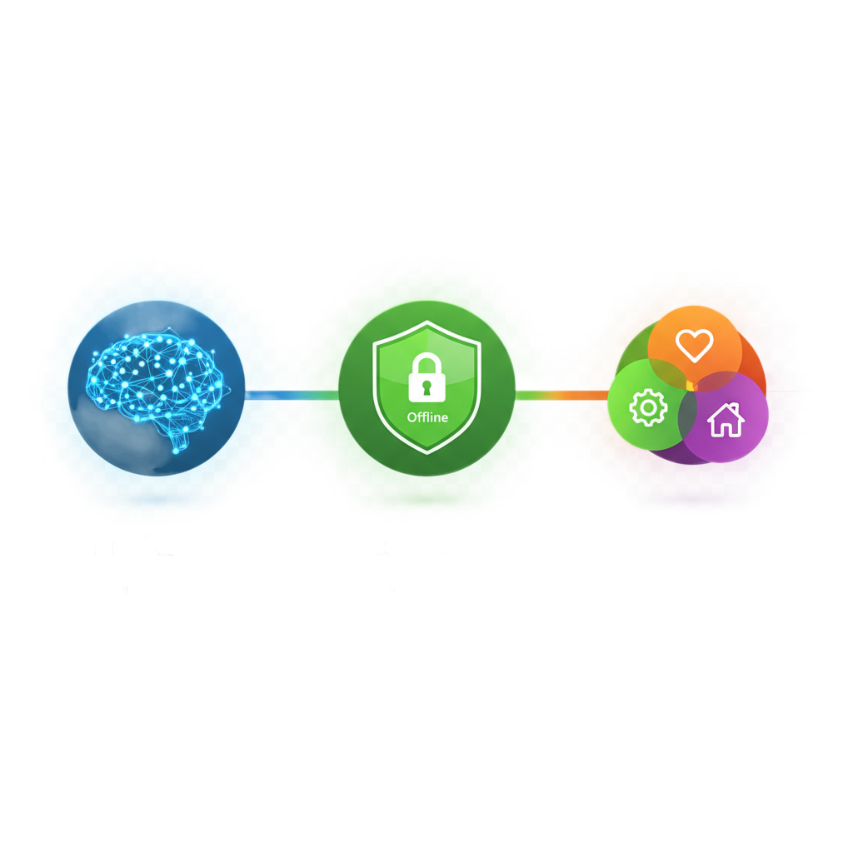
The Three Pillars of UmiDo
A New Approach to Life Management
Effortless Intelligence: Leveraging advanced AI/NLP to simplify complex tasks and provide proactive safety.
Absolute Reliability: Built on an offline-first, enterprise-grade architecture for unwavering access and data integrity.
Seamless Integration: Harmonizing health, work, and personal domains into a single, collaborative platform.

Slide 5
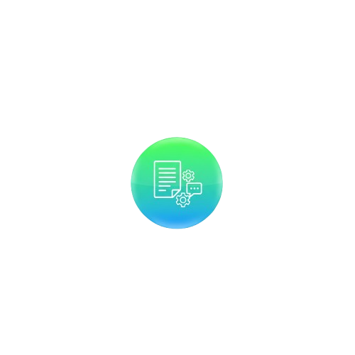
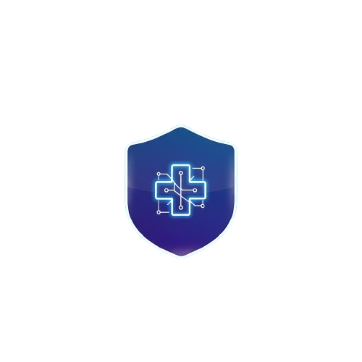
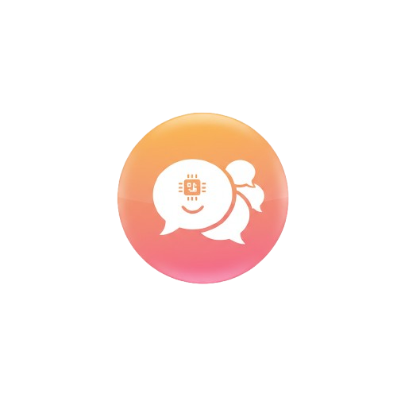
Pillar I: Effortless Intelligence - The AI Core
A suite of custom-built AI modules designed for maximum accuracy and relevance.
The guardian
The guardian
The guardian
A proprietary Drug-Drug Interaction (DDI) detection engine.
A proprietary Drug-Drug Interaction (DDI) detection engine.
A proprietary Drug-Drug Interaction (DDI) detection engine.

Slide 6
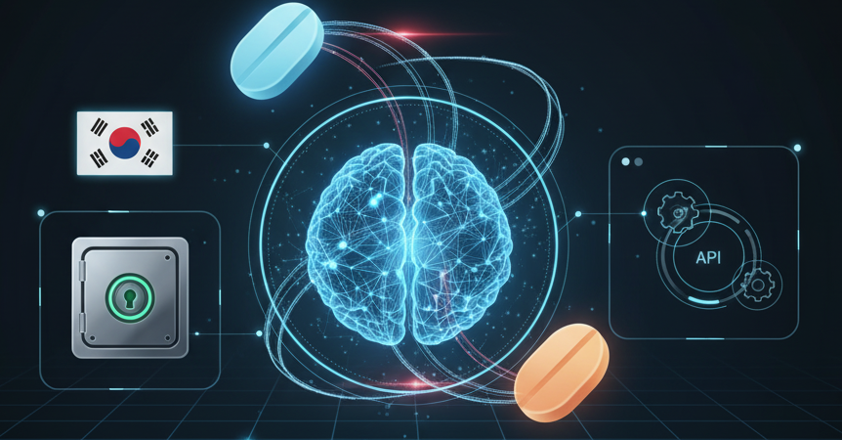
AI Module 1: The Guardian (DDI) - The Need
The Challenge: Access to commercial DDI APIs like DrugBank was restrictive, creating the need for a fully independent, autonomous solution.
Our Solution: We built a proprietary DDI prediction model from the ground up to ensure data sovereignty, local relevance for Korean medications, and seamless system integration.

Slide 7
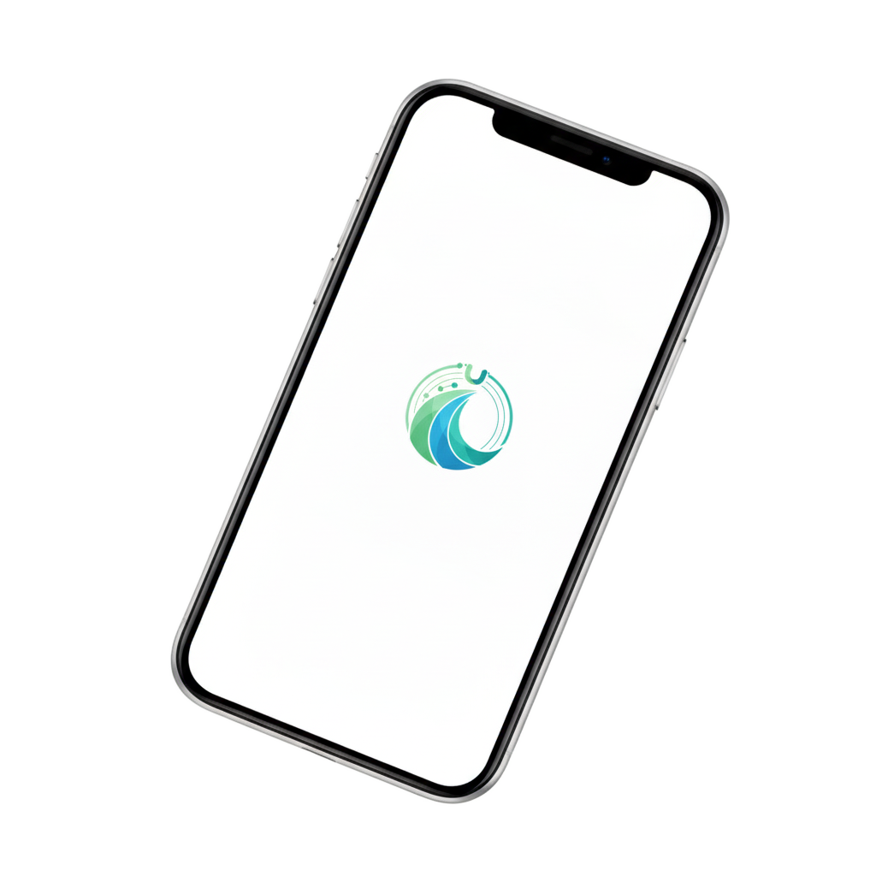
The Guardian (DDI) - Data & Feature Pipeline
Multi-Source Data Foundation:
Korean drug data from MFDS -> Biomedical literature from PubMed Abstracts -> Statistical signals from FDA Adverse Event Reporting System (FAERS)
Advanced Feature Engineering:
For each drug pair, we compute multidimensional features -> Chemical Similarity (e.g., Tanimoto coefficient) -> Biological Targets (e.g., shared proteins, CYP3A4 inhibition) ->Side Effect Overlap (e.g., common adverse reactions)

Slide 8
Model | Accuracy
Gradient Boosting | 96.12%
Neural Networks | 90.11%
Random Forest | 89.09%
Logistic Regression | 81.25%
K-Nearest Neighbors | 72.00%
The Guardian (DDI) - Model Comparison & Results
Strengths | Weaknesses
High predictive accuracy | Computationally heavier
Captures complex dependencies | Requires large training set
Robust, handles complex data | Less transparent
Simple, interpretable | Limited non-linear capture
Simple, non-parametric | Sensitive to irrelevant features
Rigorous Model Evaluation: Multiple machine learning models were trained and tested to find the highest-performing solution for predicting interaction risks.

Slide 9
Stage 1: Image Encoding -> Converts images to Base64 text for secure API transmission
Stage 2: Info Extraction -> Uses a specialized extractor to identify key entities like medication name, dosage, and frequency
Stage 3: Med Matching -> Applies RapidFuzz fuzzy string matching against a normalized drug list to ensure accuracy
Stage 4: Instruction Analysis -> A fine-tuned NLP model decodes natural language instructions into structured JSON
AI Module 2: The Translator (Parser) - 4-Stage Pipeline
Goal: To transform raw prescription images into structured, validated, and actionable data with high accuracy.

Slide 10
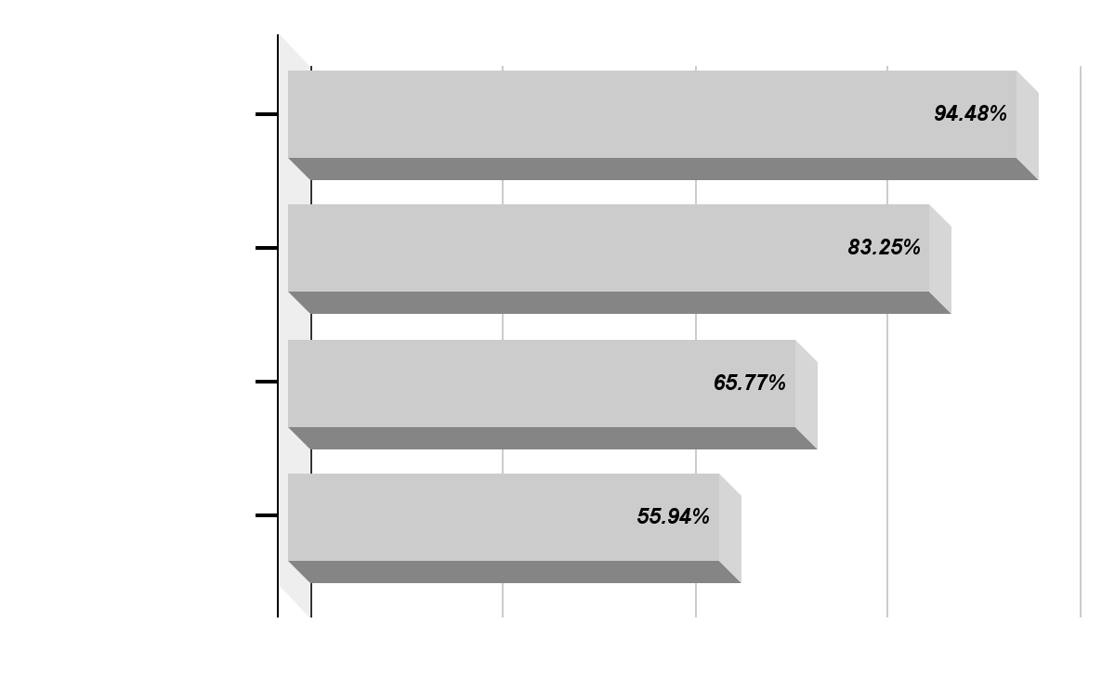
The Translator (Parser) - Information Extractor Benchmark
Choosing the Right NLP Model:
We evaluated several models to find the best for converting natural language instructions into structured data.

Slide 11
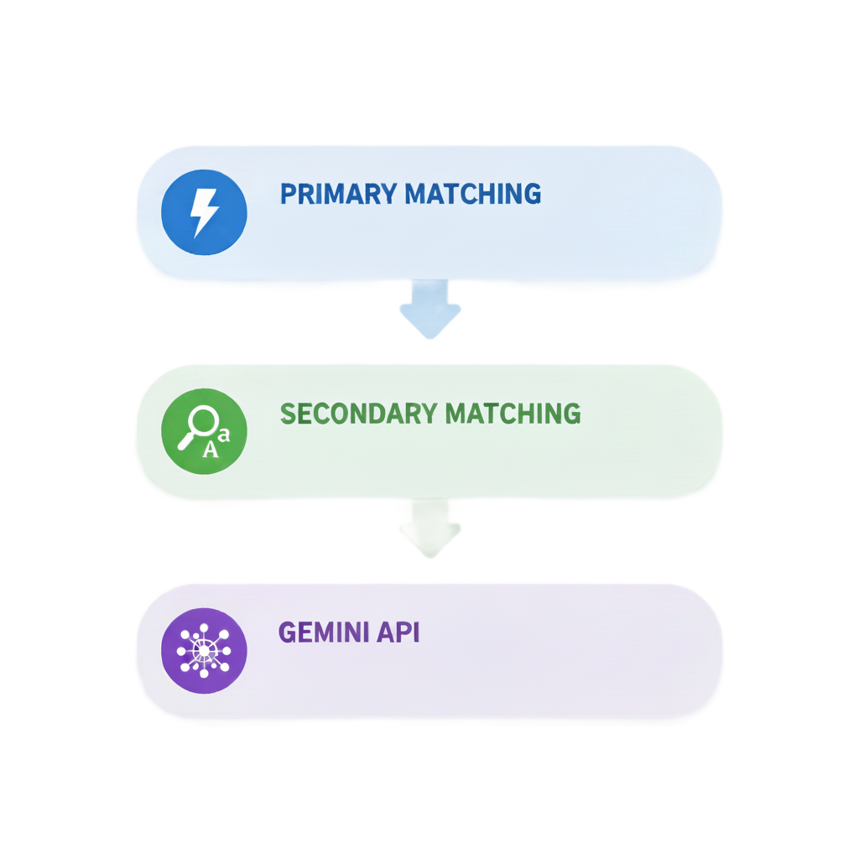
AI Module 3: The Conversationalist (Chatbot)
A Multi-Tiered Pipeline for Natural Interaction:
Tier 1: Primary Matching – Fast, keyword-based matching for common, high-confidence queries.
Tier 2: Secondary Matching (Fallback) – Flexible fuzzy string matching to handle typos and variations in phrasing.
Tier 3: Gemini API (Fallback of Fallback) – Leverages a powerful LLM to handle complex, ambiguous, or open-ended user requests, ensuring a robust and context-aware experience.

Slide 12
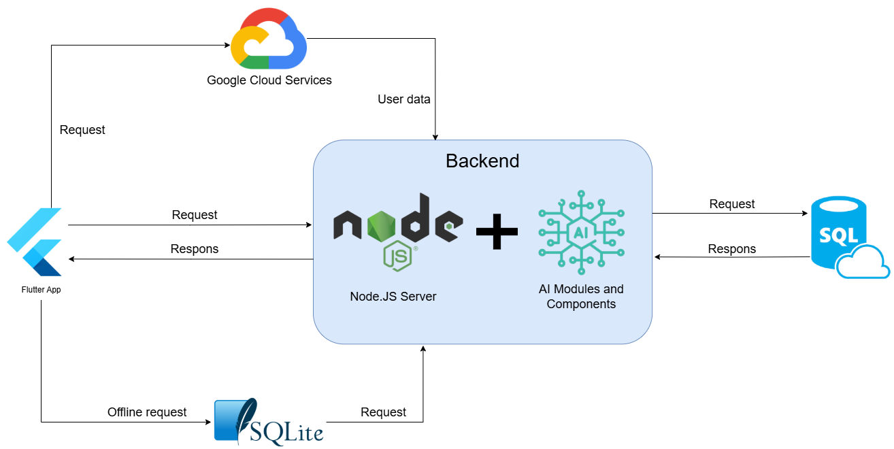
Pillar II: Absolute Reliability - System Architecture
Frontend: Flutter application for cross-platform (iOS, Android, Web) deployment.
Backend: Node.js server hosted on Microsoft Azure App Services handles all business logic and API requests.
Primary Database: Microsoft Azure SQL Database ensures data integrity and consistency.
Offline Database: On-device SQLite allows for core functionality without an internet connection.
Notifications: Firebase Cloud Messaging (FCM) delivers timely alerts and reminders.

Slide 13
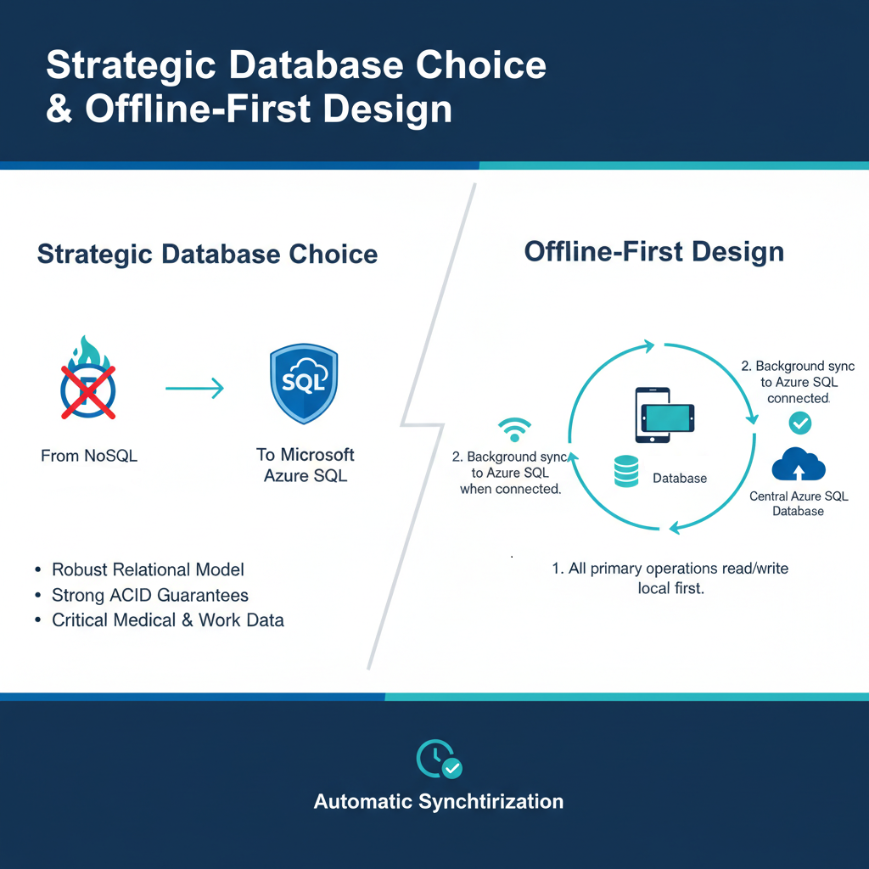
Absolute Reliability -
Data & Offline Strategy
Strategic Database Choice: Transitioned from NoSQL (Firestore) to Microsoft Azure SQL for its robust relational model and strong ACID guarantees, which are essential for handling critical medical and work data.
Offline-First Design:
All primary operations read from and write to the local SQLite database first.
A background service automatically synchronizes local changes with the central Azure SQL database when a connection is available.

Slide 14
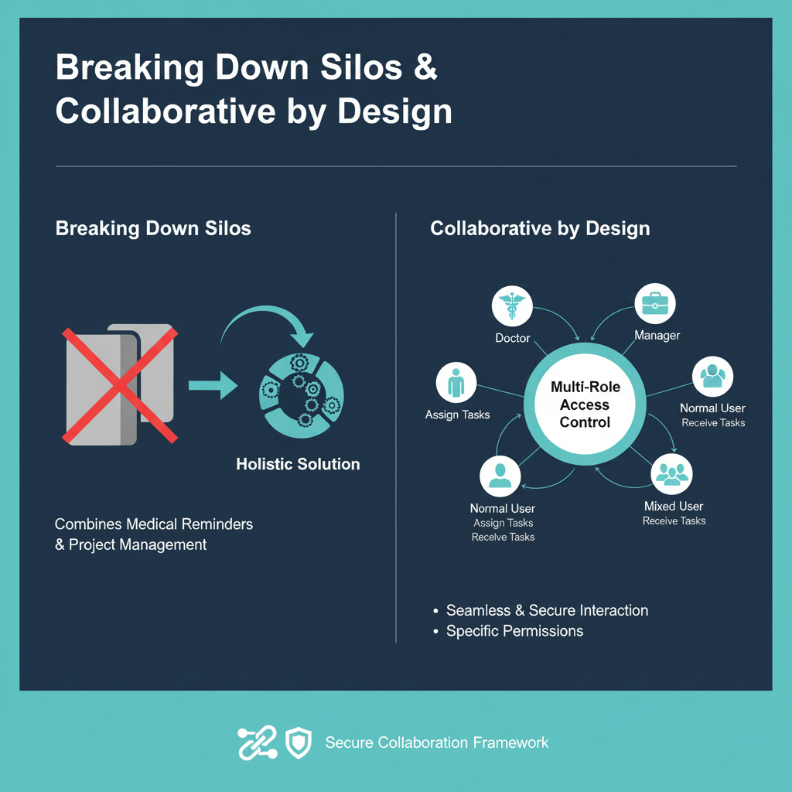
Pillar III: Seamless Integration - A Unified Platform
Breaking Down Silos: UmiDo is designed to be a holistic solution combining the strengths of dedicated medical reminder apps and project management tools.
Collaborative by Design:
Multi-Role Access Control allows for seamless and secure interaction between different user types.
Roles: Doctor, Manager, Normal, and Mixed users, each with specific permissions to assign or receive tasks.

Slide 15
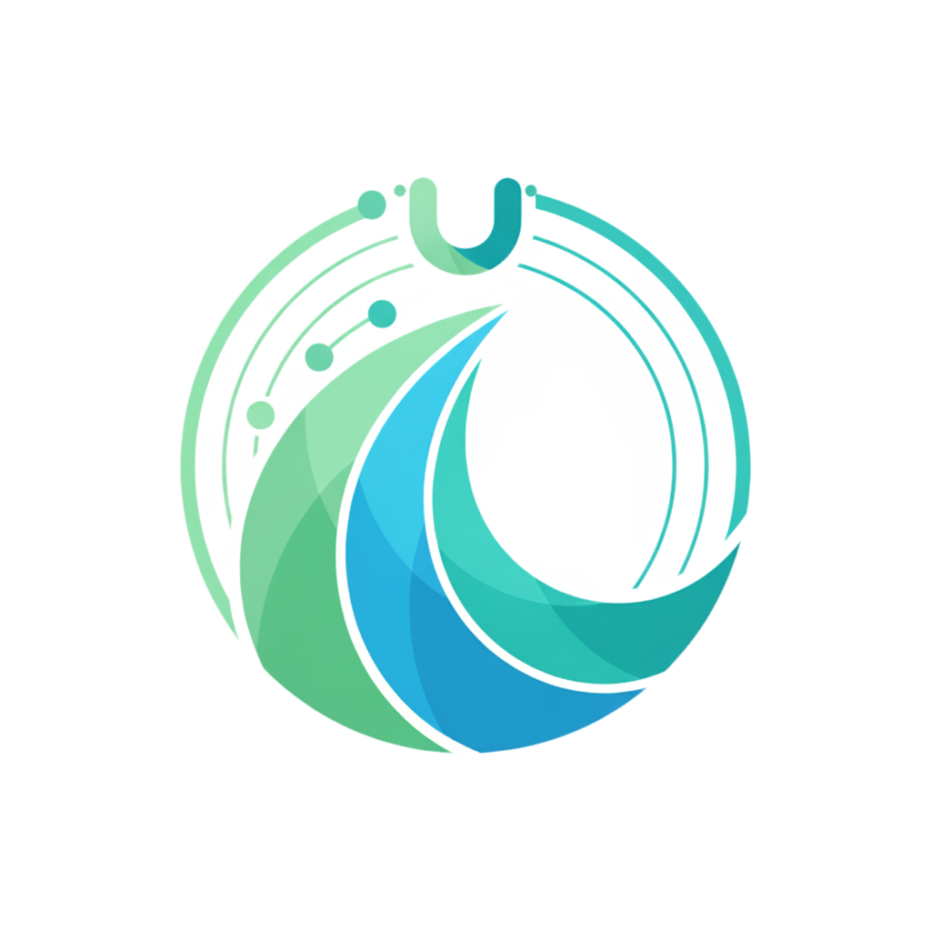
Conclusion: The Ultimate Life Assistant
More Than an App: UmiDo is an intelligent partner that reduces cognitive load and restores focus.
Key Strengths:
Our most intelligent parser: Effortlessly translates complex prescriptions into simple, actionable tasks.
Our most vigilant safety net: Proactively protects users with a highly accurate, custom-built DDI engine.
Our most intuitive interface: Provides a unified view of your life, accessible anytime, anywhere.

Slide 16
Thank You

